Slide 1
CERT Basic Training

Slide 2
Welcome
Welcome / Program Manager Introduction
Attendance-sign in
Bathrooms
Emergency exits, evacuation site and roll
Leaving at end of class
Raffle!
Introductions-Instructors and Class
(Note: Slide presentation has been adapted for Santa Cruz County. Individual slides and order may vary from Participant Manual).
CERT Basic Training Unit 1: Disaster Preparedness
1-2
Notes:
We will review Unit 1 Disaster Preparedness and Unit 2 CERT Organization today

Slide 3
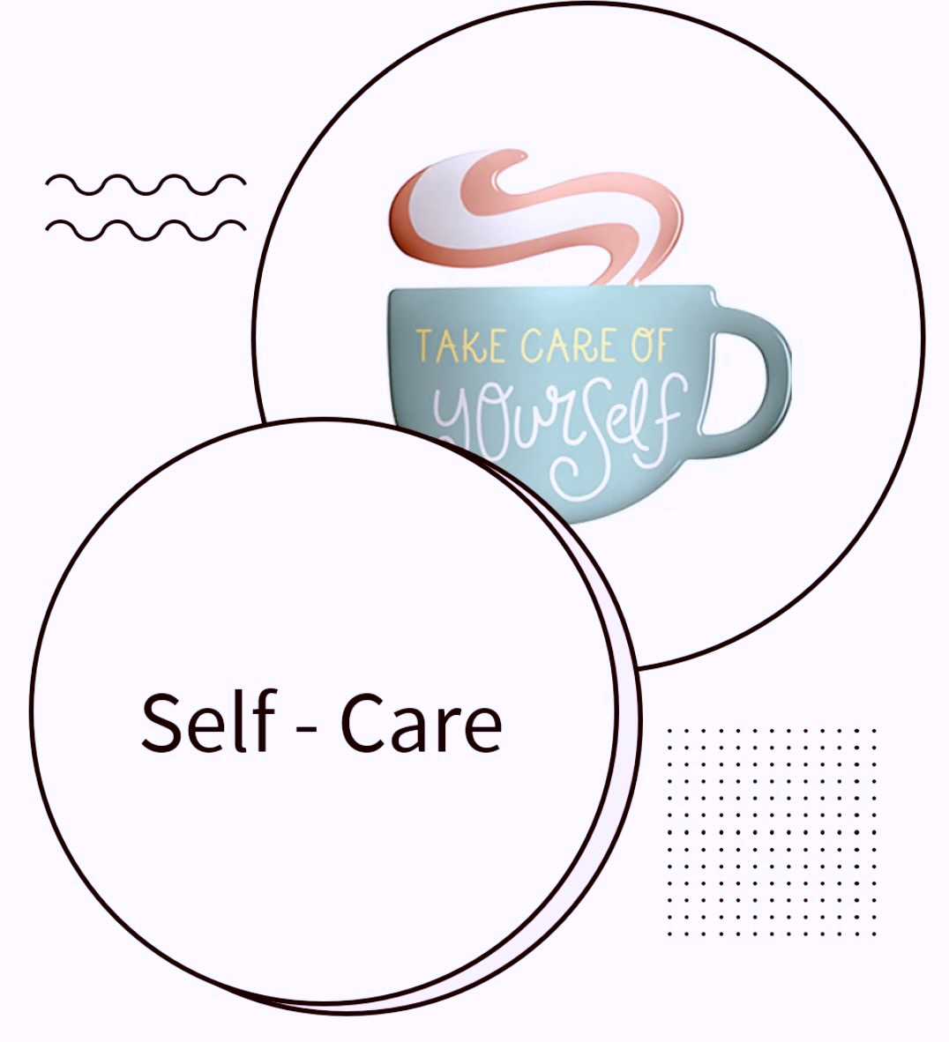
Self-care
We all have different life experiences. Discussing disasters and emergency response will affect each of us differently
Acknowledge your feelings
Breathe
Take breaks if needed
CERT Basic Training Unit 1: Disaster Preparedness
1-2
Notes:
We will review Unit 1 Disaster Preparedness and Unit 2 CERT Organization today

Slide 4
Unit 1: Disaster Preparedness
CERT Basic Training

Slide 5
Setting the Stage - History
Mexico City Earthquake of 1985
CERTs are able to:
Plan and prepare neighbors and communities for disasters
Act as immediate responders in neighborhoods and community
Assist professional responders using the Santa Cruz County CERT Operations and Activation Guide.
PM 1-1
CERT Basic Training Unit 1: Disaster Preparedness
1-4
Notes:
10,000 died. Untrained volunteers saved 700 lives, but 100 died in the process. LAFD started first CERT

Slide 6
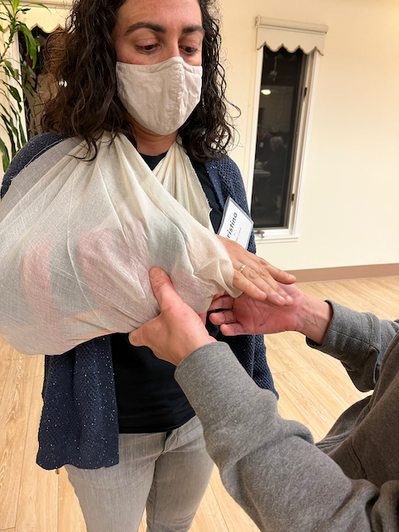
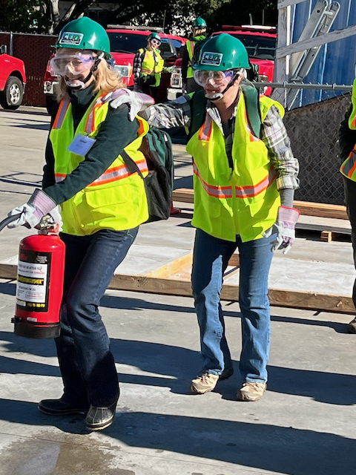
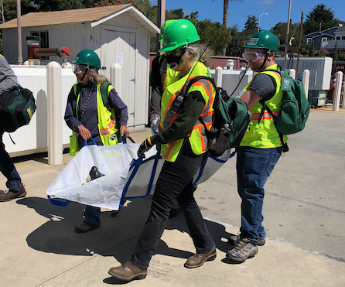
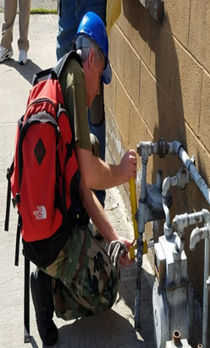
Course Preview
Disaster Preparedness
CERT Organization
Medical Operations
Disaster Psychology
Fire Safety & Utilities
CERT & Terrorism
Light Search and Rescue
Practical and Test
PM Pg 6
CERT Basic Training Unit 1: Disaster Preparedness
1-5

Slide 7
Unit 1 Objectives
Identify roles and responsibilities for community preparedness
Describe types of hazards that affect community, people, health, and infrastructure
Take personal and organizational preparedness actions
Describe functions of CERTs
PM 1-1
CERT Basic Training Unit 1: Disaster Preparedness
1-6

Slide 8
CERT Support
Educate citizens on disaster threats and how to respond
“Bridge” for professional responders in the event of disaster
Attend to family, then assist on request within limits of training
Help with non-disaster
community events
CERT Basic Training Unit 1: Disaster Preparedness
1-7

Slide 9
Activity
Work in groups of five to design and construct a free-standing tower that stands at least 5-feet tall from the bottom of the structure to the top
You will have 8 minutes. Spend the first 3 minutes planning and designing the tower as a group. While planning, you should not touch any of the materials
Wait to be told when to begin construction. You will have 5 minutes from that point to complete the tower
PM 1-2
CERT Basic Training Unit 1: Disaster Preparedness
1-8
Notes:
After, discuss working with team

Slide 10
As CERTs we may
Work with unfamiliar people
On unusual problems
With adapted tools and surroundings
Under time pressures
What skills helped?
Notes:
Before we go on, what types of disasters can you think of?

Slide 11
Type of Disasters
Natural
Technological & Accidental
Terrorism
Pandemic
PM 1-6
CERT Basic Training Unit 1: Disaster Preparedness
1-9
Notes:
Natural (e.g., earthquakes, wildfires, floods, extreme heat, hurricanes, landslides, thunderstorms, tornadoes, tsunamis, volcanic eruptions, winter storms)
Technological & Accidental (e.g., hazardous material spill, nuclear power plant accident)
Terrorism (e.g., chemical, biological, radiological, nuclear, explosive weapons)
Pandemic

Slide 12
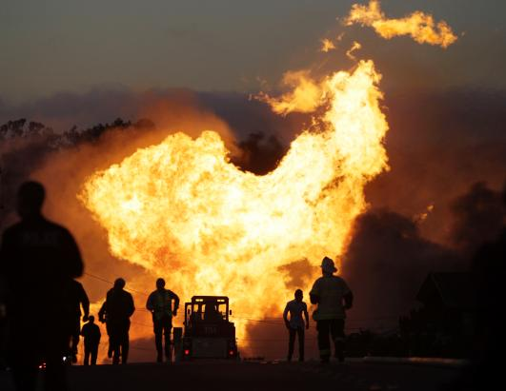
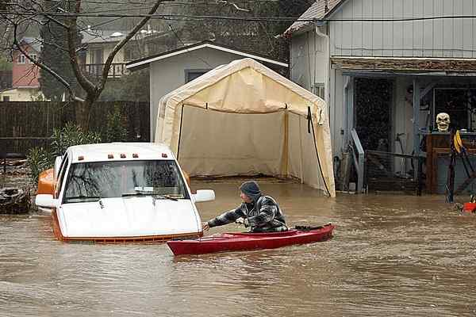
Key Disaster Elements
They are relatively unexpected
Emergency personnel may be overwhelmed
Lives, health, and the environment are endangered
Preparation will reduce impacts on people & communities
San Bruno Sep 2010
Felton Feb 2017
PM 1-6
CERT Basic Training Unit 1: Disaster Preparedness
1-10
Notes:
what about locally? What do we need to worry about?

Slide 13
Local Hazard Vulnerability
Identify common disasters
Identify hazards with severe impact
Consider historical impacts
Susceptible locations in our community
Consider what to expect from disruption of services
PM 1-6
CERT Basic Training Unit 1: Disaster Preparedness
1-11

Slide 14
Earthquakes
1906 7.9 -- North San Andreas Fault
1923 7.2 -- North Coast (San Andreas)
1964 9.2 -- Alaska (Aleutian Islands)
1984 6.2 -- Morgan Hill
1989 6.9 -- Loma Prieta
1994 6.7 -- Northridge
2014 6.0 -- Napa
CERT Basic Training Unit 1: Disaster Preparedness
1-12
Notes:
1923 in Humboldt County. Damage to homes in Ferndale area. Felt as far as SF
Morgan Hill quake near Mt Hamilton on Calaveras Fault

Slide 15
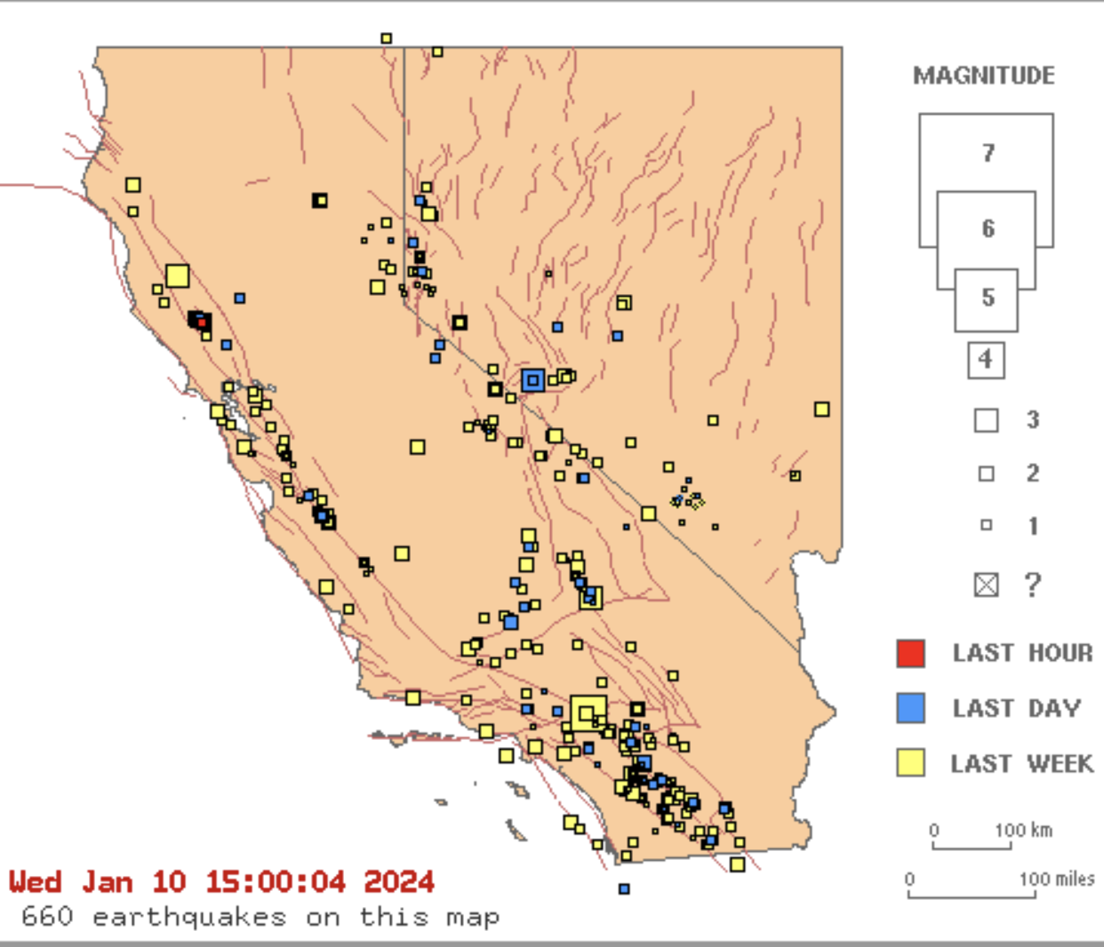
California Earthquake Activity
Seismic activity map in California
https://scedc.caltech.edu/recent/
CERT Basic Training Unit 1: Disaster Preparedness
1-13
Notes:
As of 1/10 Santa Cruz has had: (M1.5 or greater)
0 earthquakes in the past 24 hours
2 earthquakes in the past 7 days
20 earthquakes in the past 30 days
455 earthquakes in the past 365 days

Slide 16
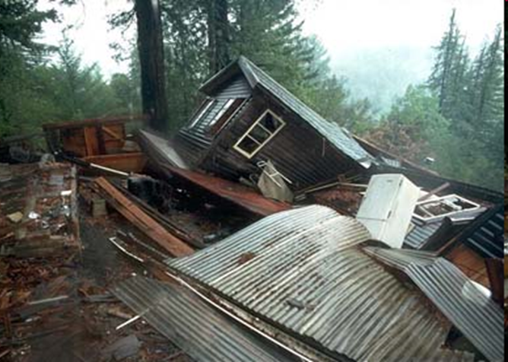
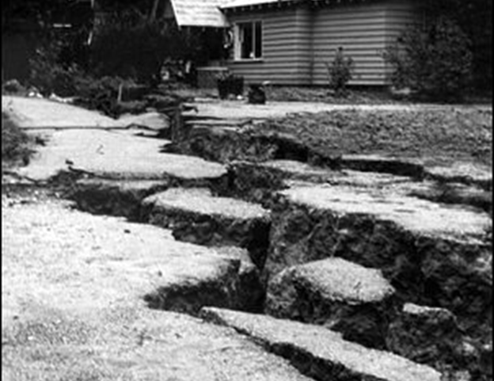
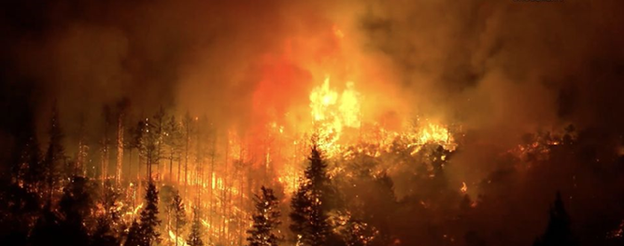
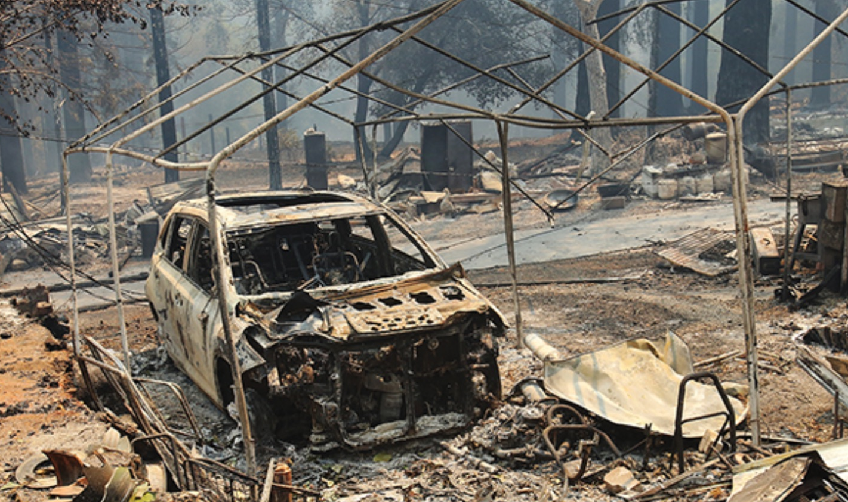
Local Hazards
Loma Prieta
1989
Bear Creek Fire 2017
CZU Fire 2020
CERT Basic Training Unit 1: Disaster Preparedness
1-14
Notes:
Add mudslide (Love Creek) / flood (1950s downtown Santa Cruz) Maybe add 2nd slide

Slide 17
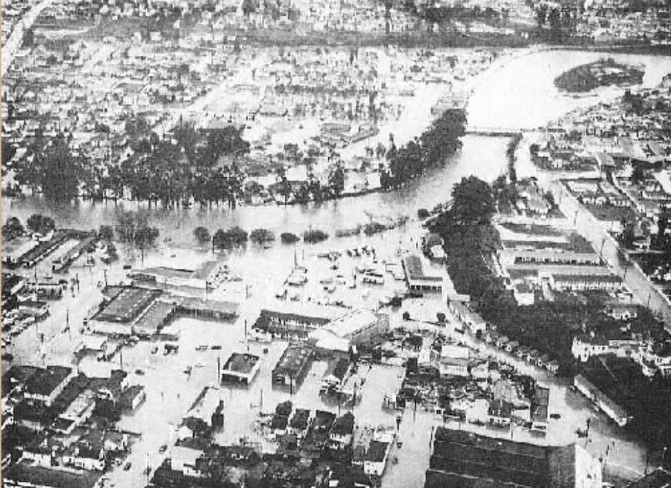
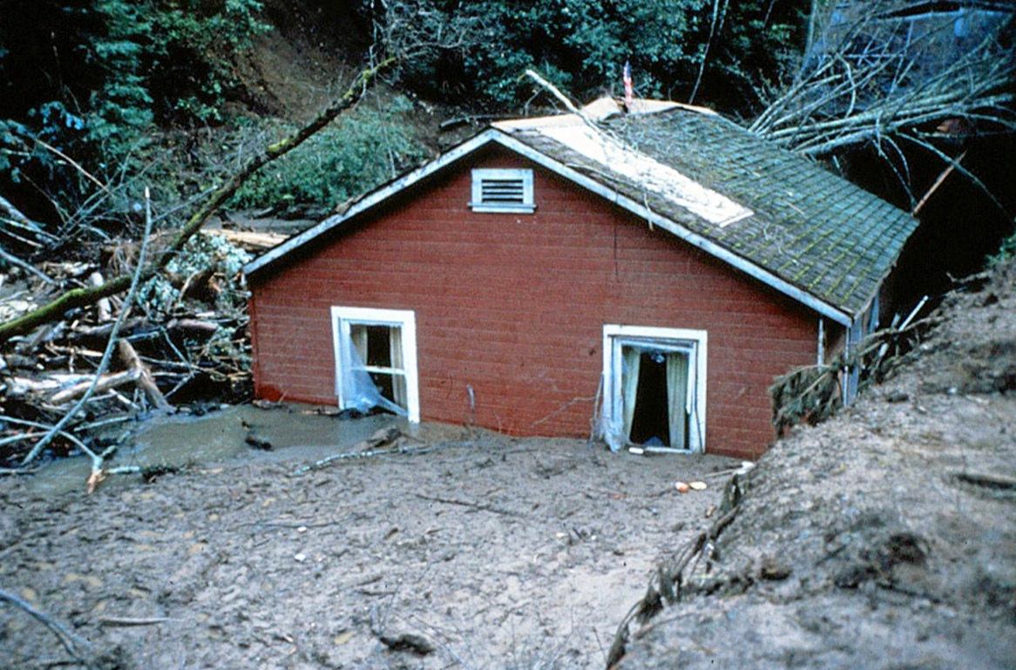
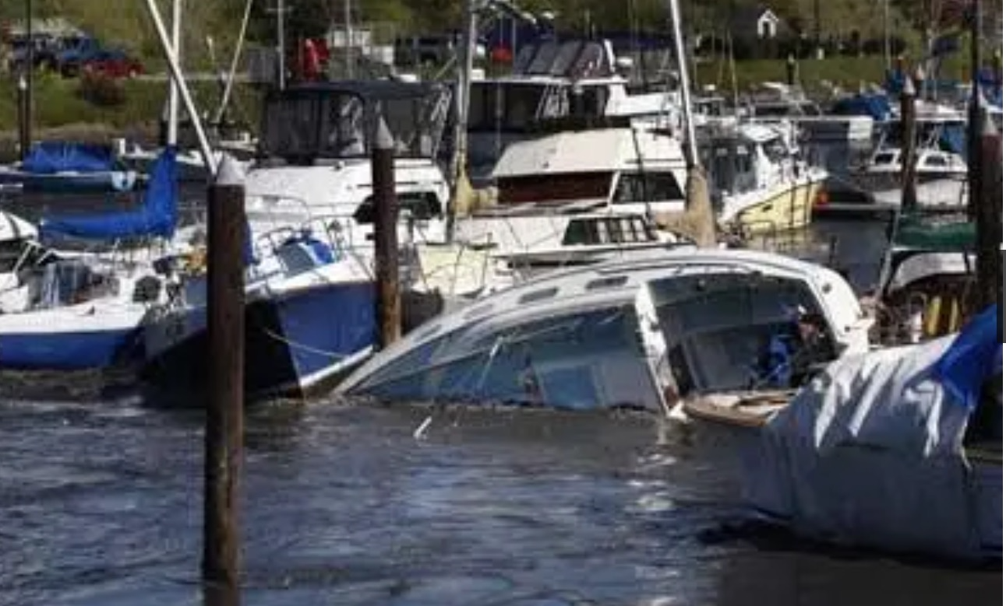
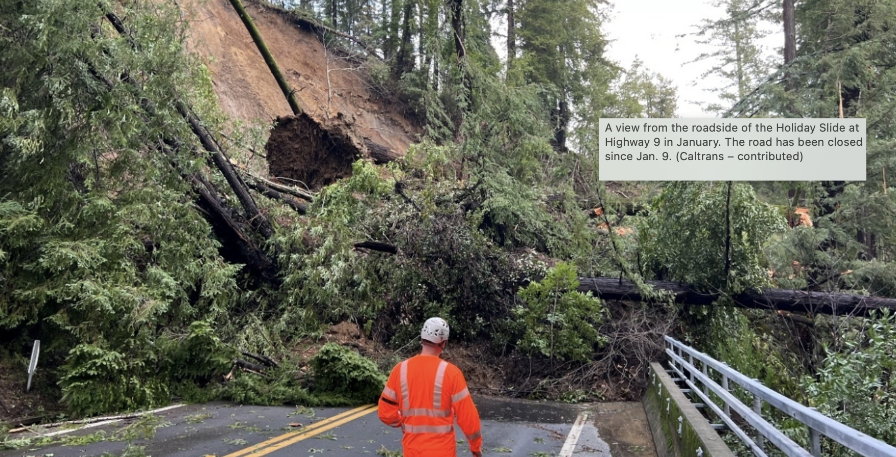
Local Hazards
Santa Cruz Flood 1955
Love Creek Slide
1982
Fukishima Tsunami
2011
Winter!
2023
CERT Basic Training Unit 1: Disaster Preparedness
1-14
Notes:
Love Creek - Ben Lomond < 8" rain in 24n hours, 18,000 slides in CA. 2000' wide, 33' deep, 10 died, 1 survivor in 9 homes buried.

Slide 18
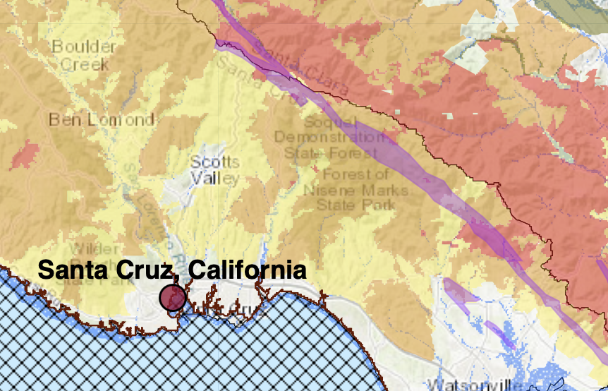
Disneyland of Disasters - North County
myhazards.caloes.ca.gov accessed 1/10/2024
1-15
Notes:
Use this for flatland classes
State fire responsibility areas, red = very high, orange= high, yellow = moderate. Purple is earthquake zone,, blue crosshatch in Santa Cruz = 100 year floodplains
myhazards.caloes.ca.gov accessed 5/14/2023. Tsunami Zone has been added in the past year

Slide 19
Fire Hazard Severity Zones
Notes:
Based on mapping done

Slide 20
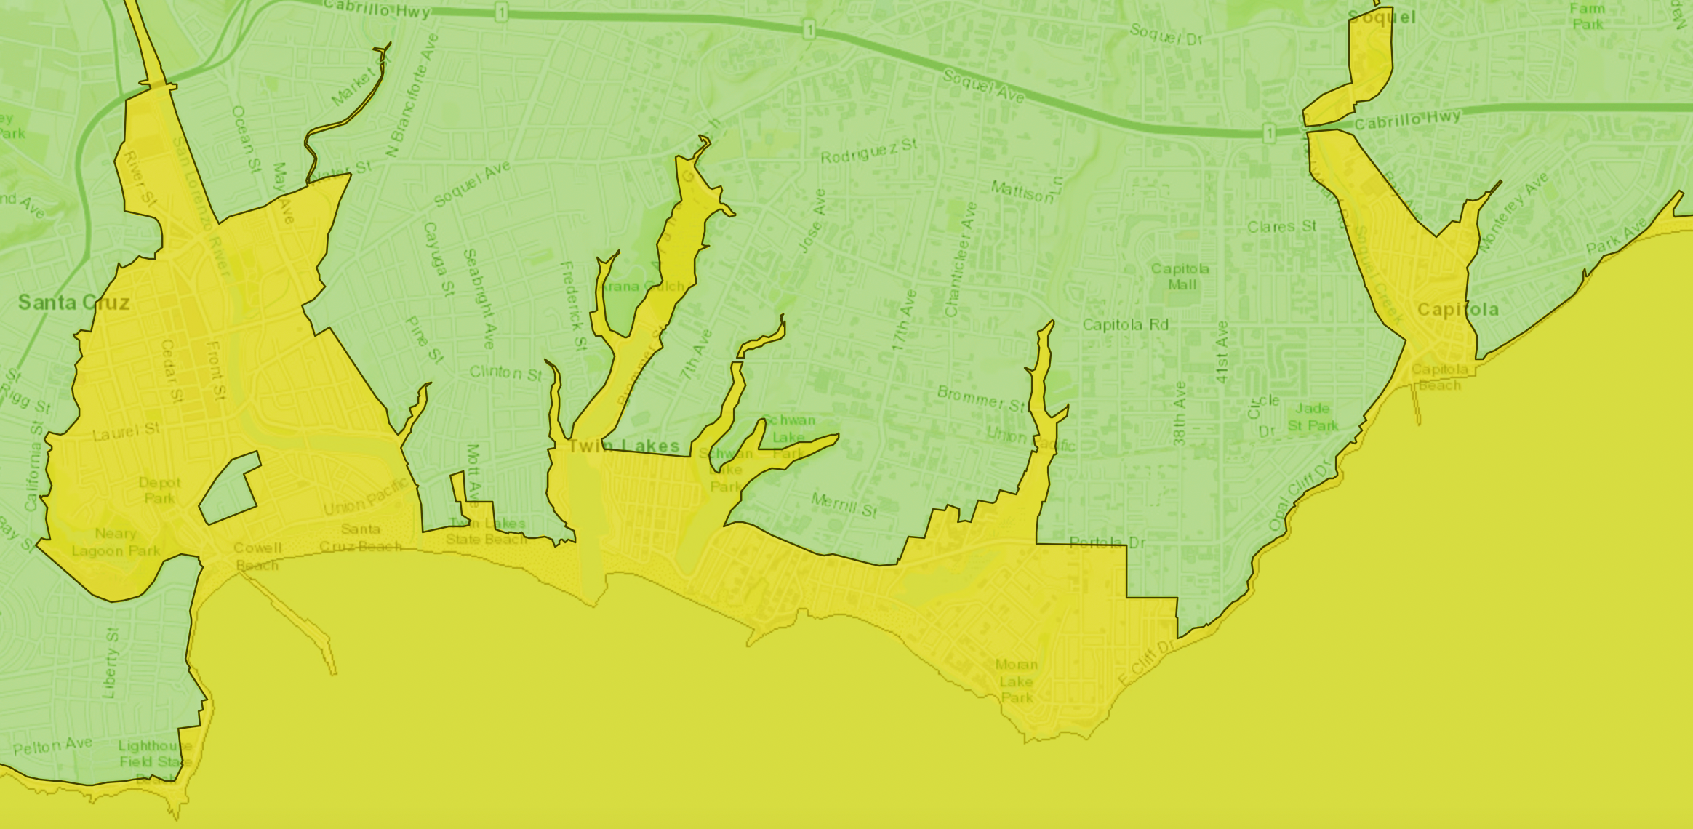
Tsunami map – Santa Cruz County
https://www.conservation.ca.gov
accessed 10/14/2022
CERT Basic Training Unit 1: Disaster Preparedness
1-15
Notes:
Use this for Watsonville classes
State fire responsibility areas, red = very high, orange= high, yellow = moderate. Purple is earthquake zone, blue crosshatch in watsonville= 100 year floodplains
myhazards.caloes.ca.gov accessed 5/8/2020

Slide 21
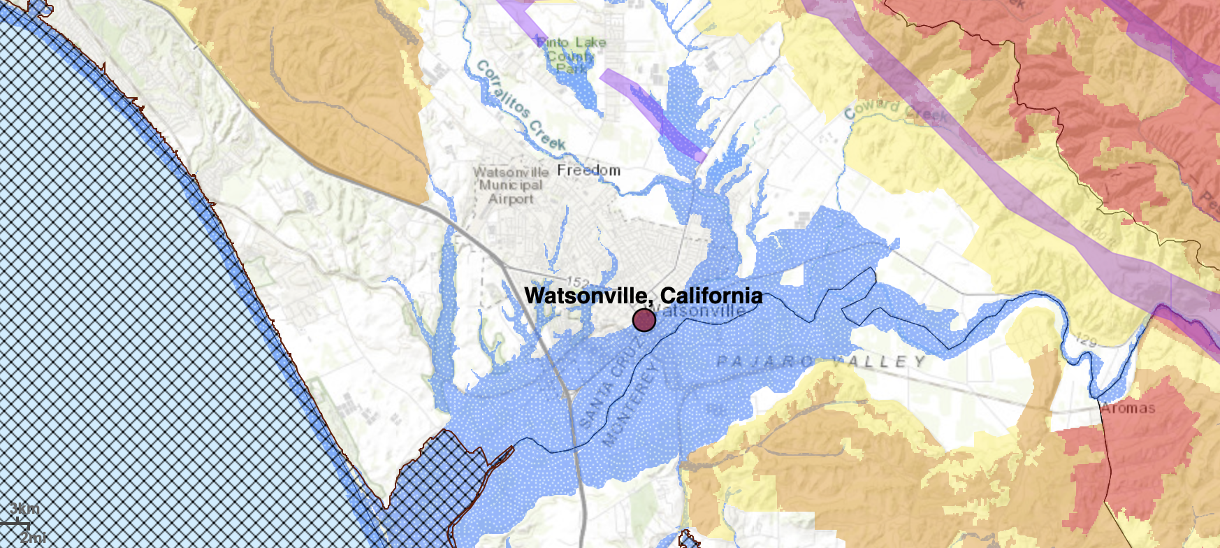
Disneyland of Disasters- South County
myhazards.caloes.ca.gov accessed 5/14/2023
CERT Basic Training Unit 1: Disaster Preparedness
1-15
Notes:
Use this for flatland classes
State fire responsibility areas, red = very high, orange= high, yellow = moderate. Purple is earthquake zone,, blue crosshatch in Santa Cruz = 100 year floodplains
myhazards.caloes.ca.gov accessed 5/14/2023. Tsunami Zone has been added in the past year

Slide 22
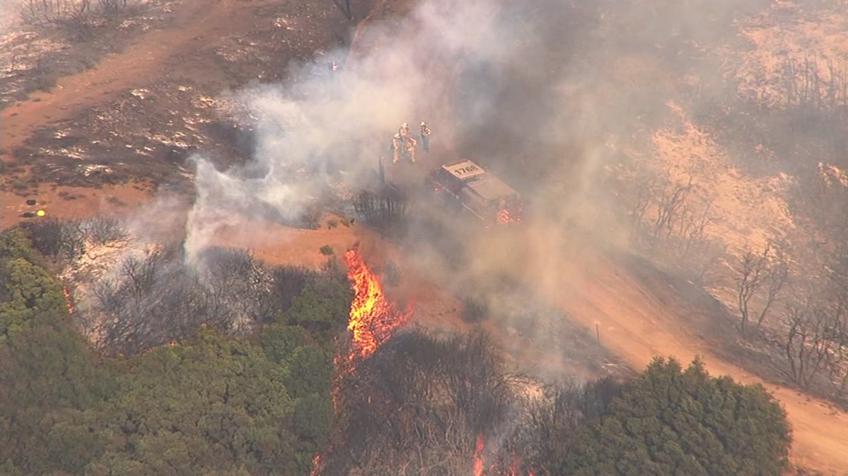
Response to Disasters
Police: address incidences of grave public safety
Firefighters: suppress major fires
EMS personnel: handle life-threatening injuries
Lower priority needs met by neighborhood and volunteer organizations
Loma Fire Sep 2016
CERT Basic Training Unit 1: Disaster Preparedness
1-16

Slide 23
Break
RETURN AT
_____
CERT Basic Training Unit 1: Disaster Preparedness
1-17

Slide 24
Community Preparedness
Preparedness is important for all communities
Key priority is to reduce the impact of disasters
Critical for all community members to prepare
Should address unique attributes of the community and engages the whole community
PM 1-3
CERT Basic Training Unit 1: Disaster Preparedness
1-18

Slide 25
Government
Government has responsibility to:
Develop, test, and refine emergency plans
Ensure emergency responders have adequate skills and resources
Provide services to protect and assist citizens
PM 1-3
CERT Basic Training Unit 1: Disaster Preparedness
1-19

Slide 26
Santa Cruz County
www.co.santa-cruz.ca.us/OR3.aspx
CERT Basic Training Unit 1: Disaster Preparedness
1-20
Notes:
Incorporated cities within the county will also have emergency response plans: Capitola, Felton, Santa Cruz, Watsonville.

Slide 27
Emergency Operations Plan (EOP)
Implemented by county EOC
Assigns responsibility to organizations and individuals
Sets forth lines of authority
Describes how people and property will be protected
Identifies personnel, equipment, facilities, supplies, and other resources
PM 1-3
CERT Basic Training Unit 1: Disaster Preparedness
1-21
Notes:
All government agencies with a role in disaster response work to organize and coordinate their agencies’ activities before an emergency or disaster using EOP’s

Slide 28
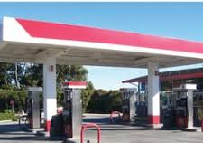
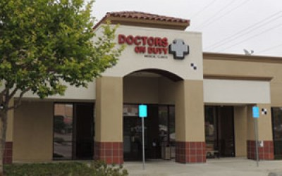
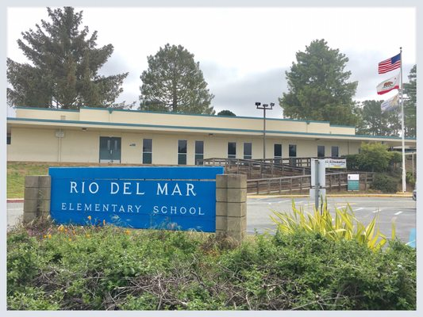
Businesses, Schools, NGO’s
Have a responsibility to participate in community preparedness
Participate in local planning council
Identify and integrate resources into government plans
Ensure that facilities, staff, and customers served are prepared
Mobilize volunteers
PM 1-4
CERT Basic Training Unit 1: Disaster Preparedness
1-22
Notes:
NGO = Non-Government Organizations (Red Cross, Salvation Army, etc)

Slide 29
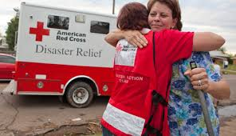
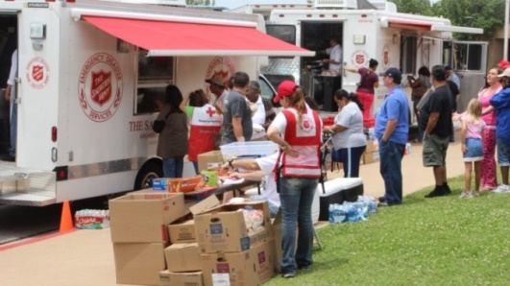
The Public
Learn about community alerts, warnings, and evacuation routes
Take training
Practice skills and personal plans
Network and help others
Provide feedback to community
Report suspicious activity
Volunteer
PM 1-4
CERT Basic Training Unit 1: Disaster Preparedness
1-23

Slide 30
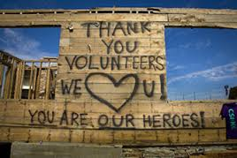
Engaging the Whole Community
Whole community approach to emergency preparedness
Social connections are the foundation for a resilient community
Community coalitions help organize community preparedness efforts
PM 1-4
CERT Basic Training Unit 1: Disaster Preparedness
1-24

Slide 31
Preparing for a Disaster(1 of 2)
Know local hazards, alerts, warning systems, evacuation routes, and sheltering plans
Implement important elements of disaster preparedness
Address specific needs for yourself, family, and community
Have the skills to evaluate the situation quickly and take effective action
PM 1-10
CERT Basic Training Unit 1: Disaster Preparedness
1-25
Notes:
Have folks look at Table 1-1 on Page 1-7. Discuss

Slide 32
Preparing for a Disaster((2 of 2)
Have a family disaster plan and practice the plan
Assemble supplies in multiple locations
Reduce the impact of hazards through mitigation
Get involved by participating in volunteer programs
PM 1-10
CERT Basic Training Unit 1: Disaster Preparedness
1-26

Slide 33
Develop a Disaster Plan
Where will your family meet?
Who is your out-of-State “check-in” contact?
Extended stay? Shelter in place? Evacuate?
How will you escape?
How will you evacuate?
Do you have transportation?
Did you practice your plan?
PM 1-12
CERT Basic Training Unit 1: Disaster Preparedness
1-27
Notes:
Refer to PM Image 1.1 on page 1-18

Slide 34
Activity – Evacuate!!!
Take the scenario given and decide what things to bring with you and/or what to do in the time available
PM 1-18
CERT Basic Training Unit 1: Disaster Preparedness
1-28
Notes:
Break into groups – See IG Page 1-27. Exercise 1.2

Slide 35
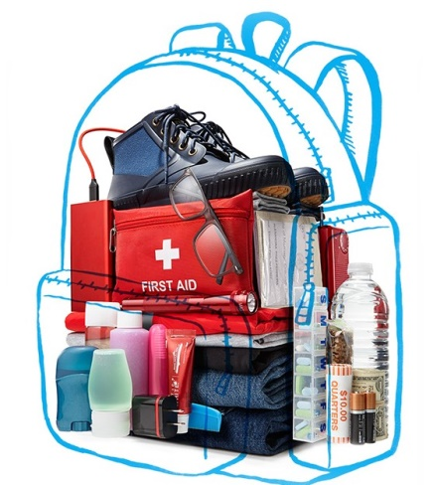
Disaster Supply Kit
After disaster strikes, you will not have time to gather supplies
Get items in advance for home confinement or evacuation (Go Bags)
You may already have these items and
need to assemble them for quick access
in an emergency
Determine how and where
to store items
PM 1-13
CERT Basic Training Unit 1: Disaster Preparedness
1-29

Slide 36
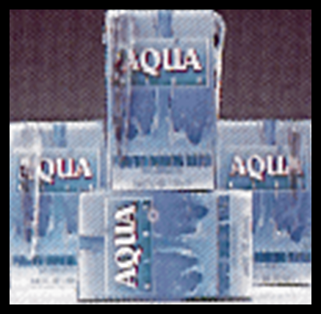
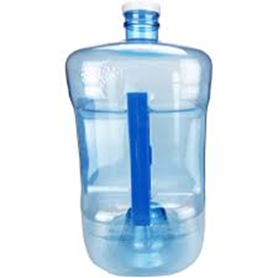
Home & Workplace Readiness
Family Supply Kit
The most important item needed is water (1 gal/person/day)
You can survive many days without food, but less than 1 week without water
CERT Basic Training Unit 1: Disaster Preparedness
1-30

Slide 37
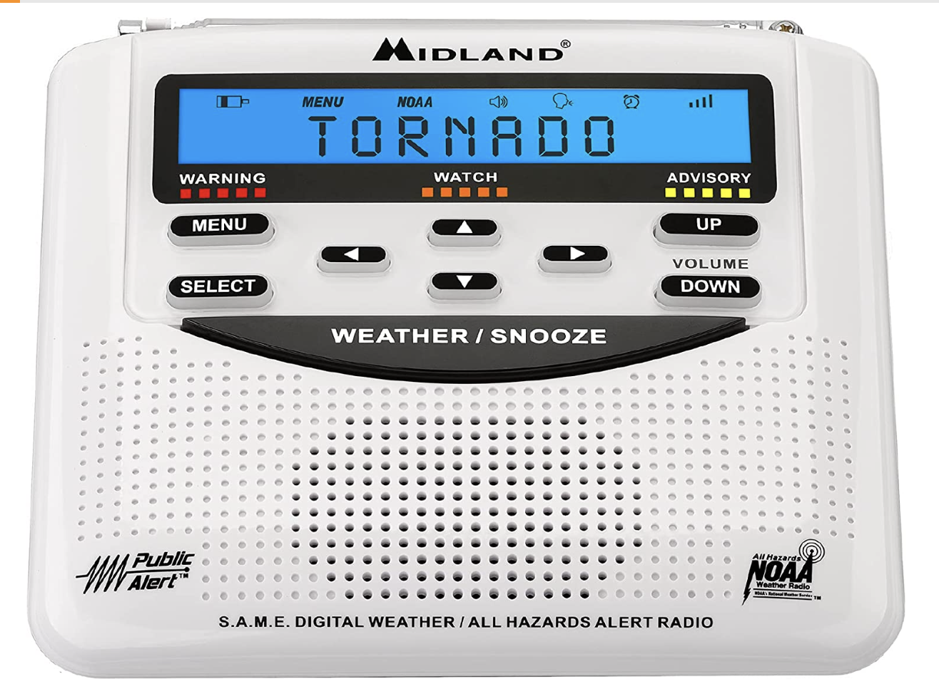
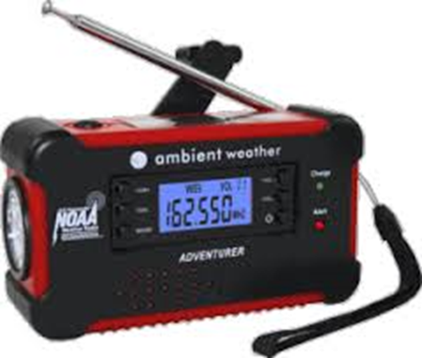
Family Supply Kit
Be sure to include medicines
Load flash drive with important information, or on cloud
Emergency radio & phone charger
Pet food and a carrier/leash
Flashlight & matches
Cash
Key stations:
*KSCO 1080 AM
KOMY 1340 AM
KZCS 88.1 FM
KSQD 89.5 FM
KBCZ 89.3 FM
Spanish
KTGE - AM 1570 (Salinas) KZSF - AM 1370 (San Jose)
KSCO CERT Basic Training Unit 1: Disaster Preparedness
1-31
Notes:
KSCO also on FM 104.1, 95.7 & 107.9, KZSC is UCSC, KSQD also 89.7 & 90.7

Slide 38
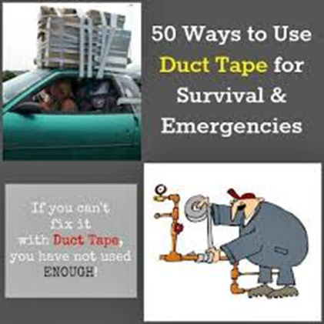
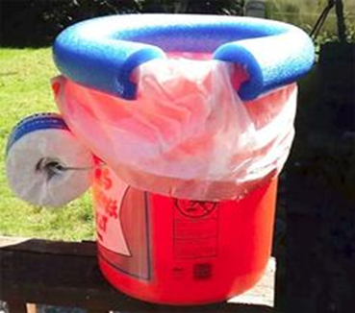
Home & Workplace Readiness
Other Supply Kit items
Duct tape
Scissors
Garbage bags
Look at Table 4.4 for preparedness lists
If you can’t fix it with Duct tape, you didn’t use enough!
PM 1-15 to17
CERT Basic Training Unit 1: Disaster Preparedness
1-32

Slide 39
Alerts
CruzAware
Register your cell phone or VOIP CruzAware.org to receive notification.
Emergency situations or critical community alerts based on geographic area
Social Media – Facebook, Instagram, X
NIXLE
Register to receive alerts from Central Fire Protection District, SVPD, Watsonville PD
nixle.com
Community Connect ScottsValleyFire.com
CERT Basic Training Unit 1: Disaster Preparedness
1-33
Notes:
(For example, evacuations, bio-terrorism alerts, missing person reports, and severe weather alerts)

Slide 40
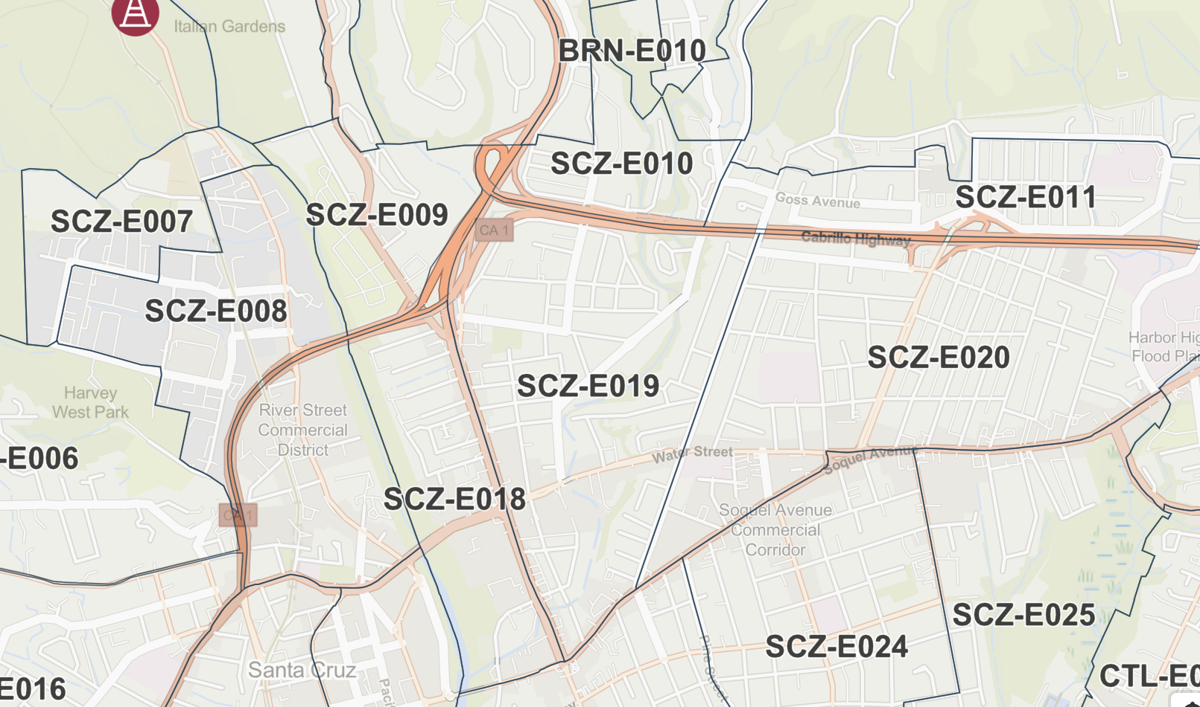
Alerts – Know Your Zone!
Protect.genasys.com
CERT Basic Training Unit 1: Disaster Preparedness
Notes:
(For example, evacuations, bio-terrorism alerts, missing person reports, and severe weather alerts)

Slide 41
Alert Apps
https://www.santacruzcountyca.gov/OR3/Response.aspx
CERT Basic Training Unit 1: Disaster Preparedness
1-33
Notes:
(For example, evacuations, bio-terrorism alerts, missing person reports, and severe weather alerts)

Slide 42
Alert Apps
PulsePoint.org
Phone app
Choose local agencies
CERT Basic Training Unit 1: Disaster Preparedness
1-33
Notes:
(For example, evacuations, bio-terrorism alerts, missing person reports, and severe weather alerts)

Slide 43
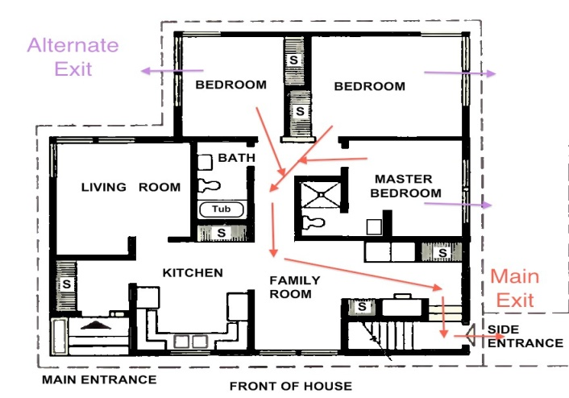
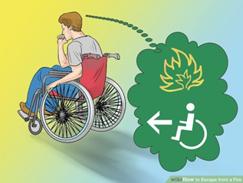
Escape Planning
Consider access and functional needs of all individuals
Inform all family members or
co-workers of the plan
Practice escape drills
PM 1-17
CERT Basic Training Unit 1: Disaster Preparedness
1-34

Slide 44
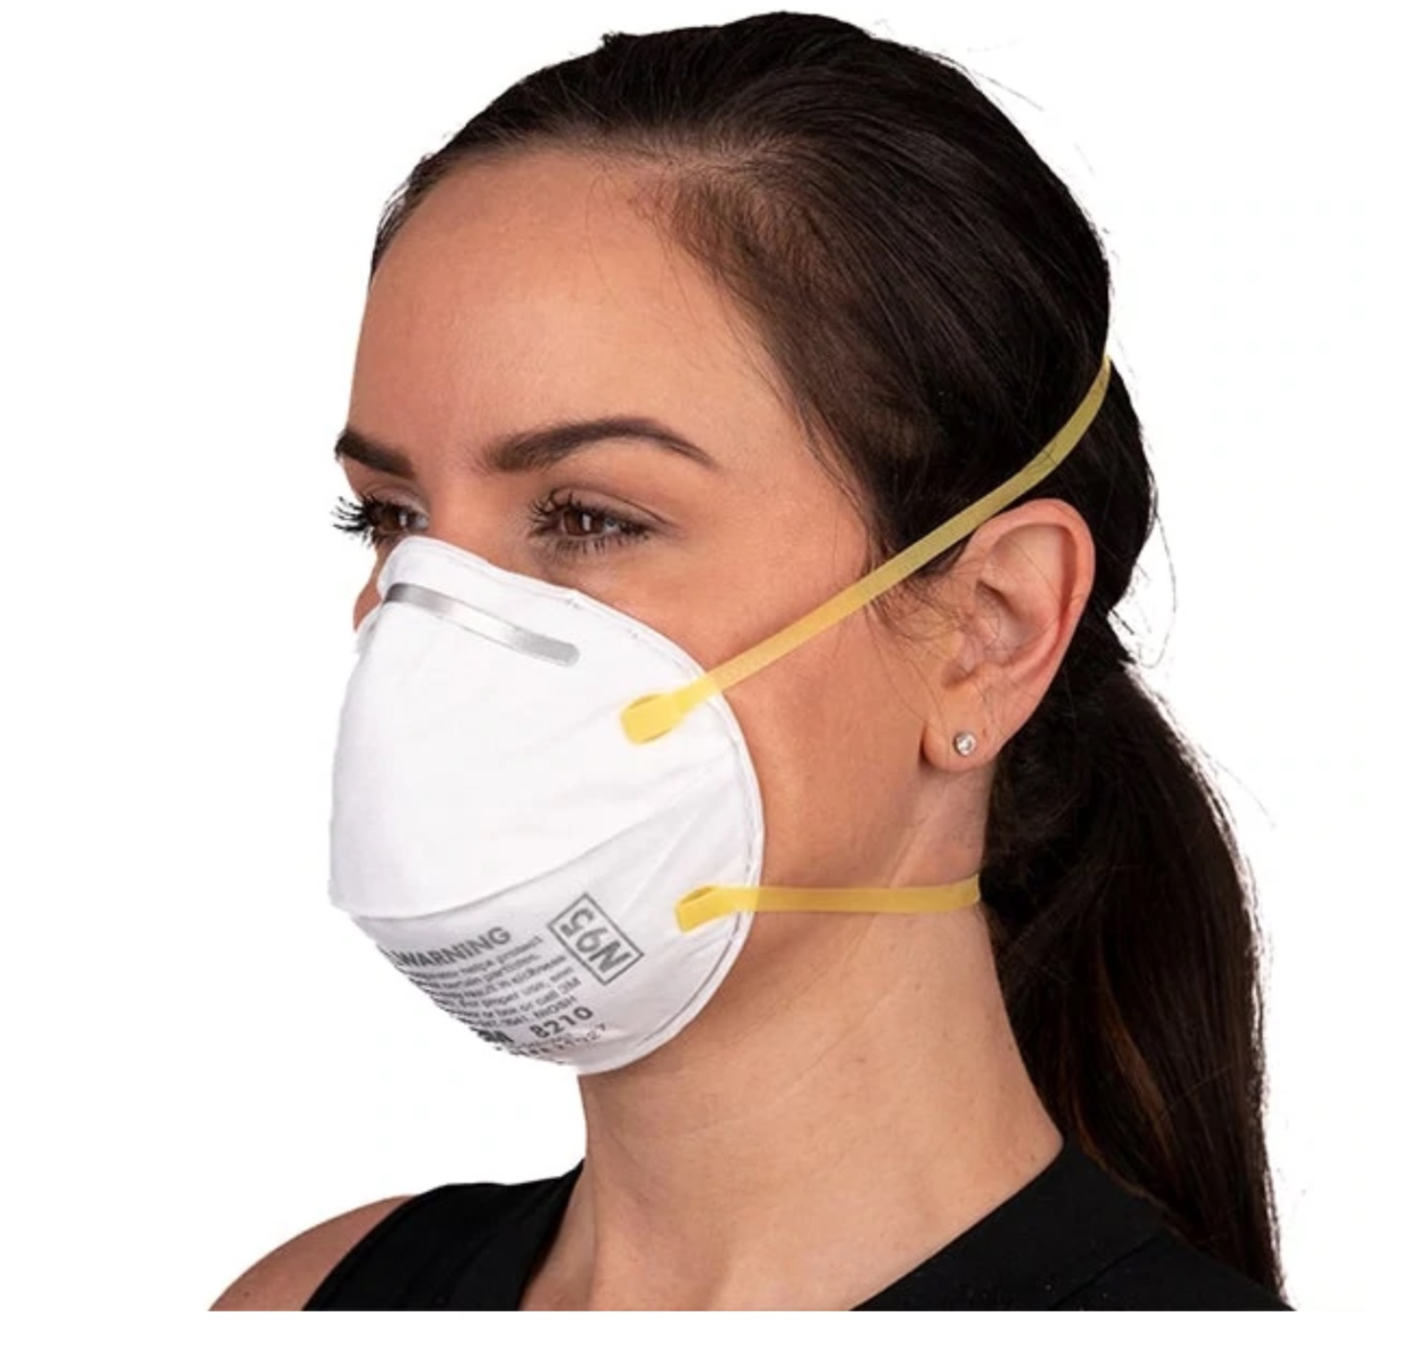
Protective Actions
Assess situation
Critical early decision in disasters
- evacuate or shelter in place?
Seek clean air and protect breathing passages
Protect yourself from debris and signal for help if trapped
Remove contaminants
Practice good hygiene
PM 1-18
CERT Basic Training Unit 1: Disaster Preparedness
1-35
Notes:
Note – this is a whoops mask. Next slide fixes it for fun

Slide 45
Sheltering
Shelter in place: sealing a room
Identify internal room
Stay for several hours
Store supplies
Shelter for extended stay
Stay for several days or up to 2 weeks
Store emergency supplies
Mass care or community shelter
Take 3-day disaster kits
Shelters provide some supplies
PM 1-19
CERT Basic Training Unit 1: Disaster Preparedness
1-36

Slide 46
Mitigation
Mitigation is the reduction of loss of life and property by lessening the impact of disasters and includes any activity that prevents an emergency or reduces effects of hazards
CERT members should have adequate homeowners / renters coverage
Consider additional insurance if in a high hazard area
PM 1-20
CERT Basic Training Unit 1: Disaster Preparedness
1-37

Slide 47
Damage Related to Structure Type
Types of damage vary by structure
You may not have opportunity to select type of structure when a disaster occurs
Engineered buildings have performed well in most types of disasters
Differences in hazards and mitigation between single-family homes and multiple-unit dwellings
PM 1-8
CERT Basic Training Unit 1: Disaster Preparedness
1-38
Notes:
Mention the new office building – Oregon State Treasury

Slide 48
Home Hazards
Gas line ruptures from water heaters or ranges displaced by shaking, water, or wind
Damage from falling books, dishes, or other cabinet contents
Risk of injury or electric shock from displaced appliances and office equipment
Fire from faulty wiring, overloaded plugs, frayed electrical cords
PM 1-9
CERT Basic Training Unit 1: Disaster Preparedness
1-40

Slide 49
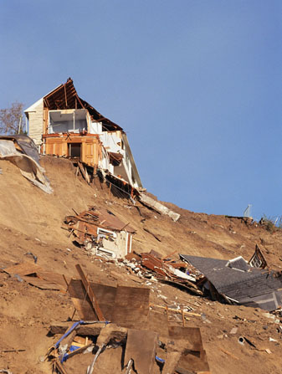
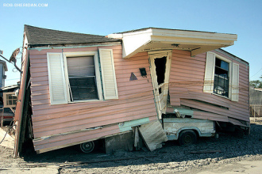
Structural Mitigation Measures
Secure house or mobile home
to foundation or slab
Install trusses or hurricane
straps to reinforce roof
Strap propane tanks and
chimneys
Raise utilities above flood level
Build a safe room
PM 1-20
CERT Basic Training Unit 1: Disaster Preparedness
1-39

Slide 50
Non-Structural Mitigation Measures
Anchor heavy furniture
Move beds away from tall bookcases
Secure appliances and office equipment
Childproof cabinet doors
Secure water heaters; have flexible gas lines installed
Locate and label gas, electricity and water shutoffs
PM 1-20
CERT Basic Training Unit 1: Disaster Preparedness
1-41

Slide 51
Fortifying Your Home
Non-structural hazard mitigation:
Home fires: Burglar bars and locks on outside window entries easy to open from the inside
Landslides: Flexible fittings are more breakage resistant
Wildfires: Reduce fuel sources
Avoid wooden shakes and shingles
Clear flammable vegetation up to 30 feet from home and remove climbing vines from walls of home
PM 1-21
CERT Basic Training Unit 1: Disaster Preparedness
1-42

Slide 52
Wildfire Mitigation Suggestions
Clean roofs and gutters
Remove dead limbs, leaves and other litter
Mow dry grass and weeds
Maintain irrigated greenbelt
Prune branches to above 20 feet from the ground (reduce ladder fuel)
Stack firewood / combustible materials away from the house
CERT Basic Training Unit 1: Disaster Preparedness
1-43

Slide 53
Get Involved
Preparedness requires active participation from all
Talk to friends and family about hazards
Ask about emergency planning outside the home
Make sure those in charge have a plan
Training provides skills needed to help others and keep skills current
CERT program provides training, practice, and connection to others
Participate in drills and exercises
Talk to friends / family about volunteering
PM 1-5
CERT Basic Training Unit 1: Disaster Preparedness
1-44
Notes:
Firewise and Map Your Neighborhood

Slide 54
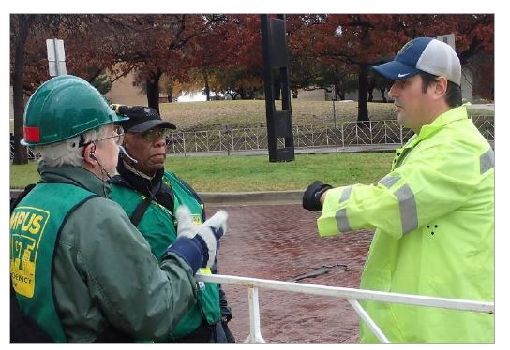
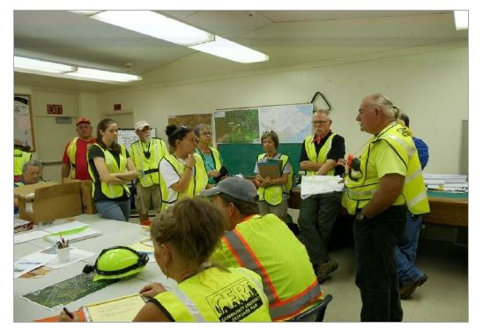
CERT in Action
CERTs respond post-disaster by:
Treating life-threatening injuries until
professional assistance is available
Helping disaster survivors cope with their
emotional stressors
Locating and turning off utilities if safe to do so
Extinguishing small fires
Conducting light search and rescue
operations
PM 1-22
CERT Basic Training Unit 1: Disaster Preparedness
1-45

Slide 55
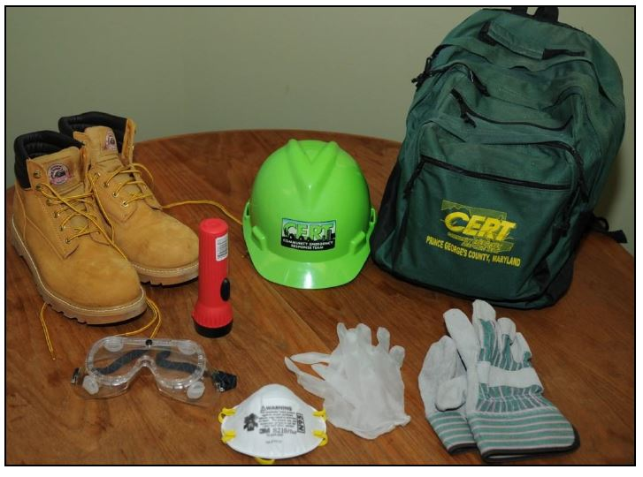
Personal Protective Equipment
Helmet
Goggles
N-95 Mask
Gloves (work and non-latex)
Sturdy shoes or work boots
Reflective vest
PM 1-24
CERT Basic Training Unit 1: Disaster Preparedness
1-46

Slide 56
Non-Disaster Roles
Identify and aide neighbors/ coworkers who might need assistance
Distribute preparedness materials; do demos
Staff first aid booths at special events
Participate in parade route management
Distribute community health information
PM 1-24
CERT Basic Training Unit 1: Disaster Preparedness
1-47

Slide 57
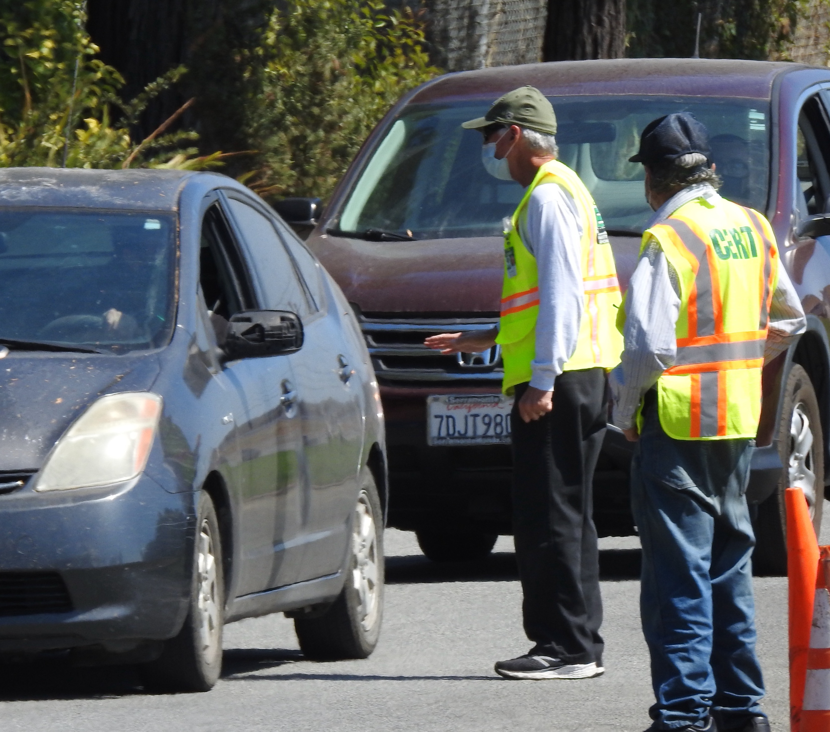
Protection for Disaster Workers
CERT members are generally protected by:
“Good Samaritan” laws
Volunteer Protection Act of 1997
Relevant state statutes
DSW liability insurance
Not liable for civil damages if acting
in good faith as trained, without payment
PM 1-24
CERT Basic Training Unit 1: Disaster Preparedness
1-48

Slide 58
Additional Training & Resources
Map Your Neighborhood
Firewise
Advanced first aid
Animal issues in disasters
Automated External Defibrillator (AED) use
Community relations
CPR skills
Debris removal
Special needs concerns
Traffic/crowd control
Utilities control
Online courses (FEMA,
Red Cross)
PM 1-26
CERT Basic Training Unit 1: Disaster Preparedness
1-49

Slide 59
Unit Summary (Unit 1)
You should now be able to:
Identify roles and responsibilities for community preparedness
Describe types of hazards that affect communities, people, health, and infrastructure
Take personal and organizational preparedness actions
Describe functions of CERTs
PM 1-27
CERT Basic Training Unit 1: Disaster Preparedness
1-50

Slide 60
Homework Assignment (Unit 1)
Review detailed information for Unit 1
Discuss preparedness with family and friends, develop communications plan
Assemble supplies in multiple locations
Examine your home for hazards
PM 1-27
CERT Basic Training Unit 1: Disaster Preparedness
1-51

Slide 61
Break
RETURN AT
_____
for
Unit 2
CERT
Organization
CERT Basic Training Unit 1: Disaster Preparedness
1-52

